Slide 1



Power BI with Dynamics 365
- Mihir Shah MCSA
Mihir Shah

Slide 2


Speaker Profile
Mihir Shah
Solutions Architect - IBM
@mihircrm
Blog – 365withoutcode.blogspot.com
Love visiting National Parks along with family - camping and RV trips
Power BI with Dynamics 365 @mihircrm 2-29-2020

Slide 3
Power BI with Dynamics 365
Dynamics 365 / Power Apps
Portals
Performance
Security considerations
Power BI with Dynamics 365 @mihircrm 02-29-2020

Slide 4
Power BI – The UI for BI (& AI)
PowerBI.com Service PowerBI Desktop PowerBI Mobile PowerBI Report Server (on-premise)
To create, share and consume visual business insights from data
Connectors for multiple sources of data
AI powered data modelling (with PowerBI Premium)
Azure service
Stores data in Azure Blob
Collection / Apps
Dataset
Visualizations
Reports
Dashboards
Insights
Power BI with Dynamics 365 @mihircrm 02-29-2020

Slide 5
Power BI licensing
Description | Free | Pro | Premium
Create Visuals | Yes | Yes | Yes
Share Visuals | No | Yes | Yes
View shared visuals | No | Yes | Yes
Dataset size (each) | 1 GB | 1 GB | 10 GB
Storage (max) | 10 GB | 10 GB per user | 100 TB
Environment | Shared | Shared | Dedicated
Max auto refresh daily | 8 | 8 | 48
Cost | Free | $9.99 per user per month | Starting at @$4,995.00
Power BI with Dynamics 365 @mihircrm 01-24-2020

Slide 6
The process
1. Connecting
2. Creating
Power BI Visuals / Apps
3. Sharing / Security
Sharing with other users
4. Embedding
Embedding in Dynamics 365 (CE / Portals)
Data sets / Reports / Dashboards
Connecting to Dynamics 365
PowerBI.com
PBI Desktop
Row level Security
Power BI with Dynamics 365 @mihircrm 02-29-2020

Slide 7
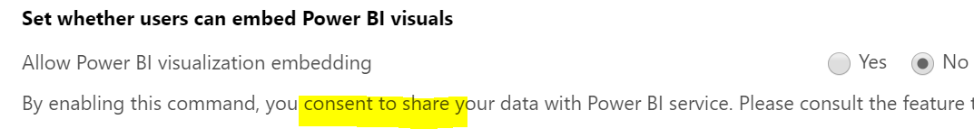
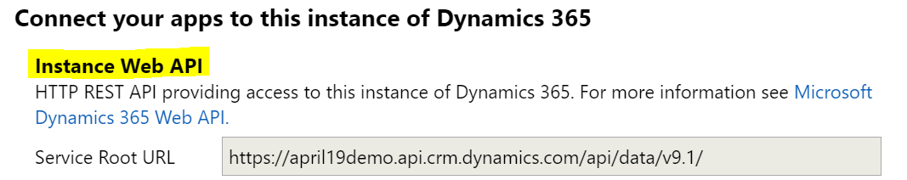
Connect Power BI to Dynamics 365
Enable in System Settings – Reporting tab
Power BI Desktop – Requires Web API and user information
Settings > Customizations > Developer resources
Power BI with Dynamics 365 @mihircrm 01-24-2020

Slide 8
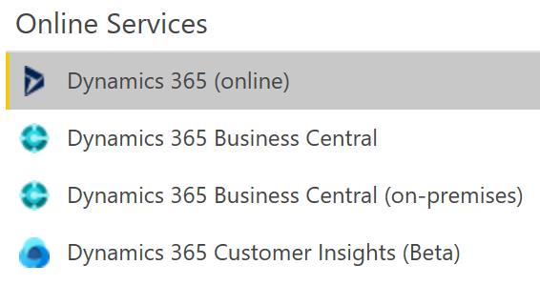
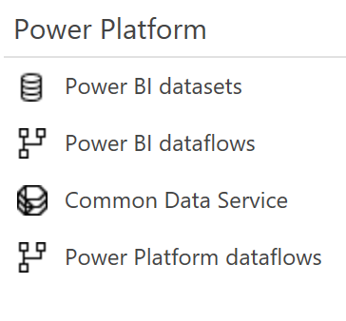
Connect options – Get Data >
Power BI with Dynamics 365 @mihircrm 02-29-2020

Slide 9
Tip - Option sets in D365
The Power Platform connector brings in the Option Set display name
You can also use Dynamics 365 online / XRM Toolbox with Option Set Generator to work with option sets in Power BI
Multi-select option sets are not yet available to connect – Manually export to excel / csv and import
Power BI with Dynamics 365 @mihircrm 02-29-2020

Slide 10
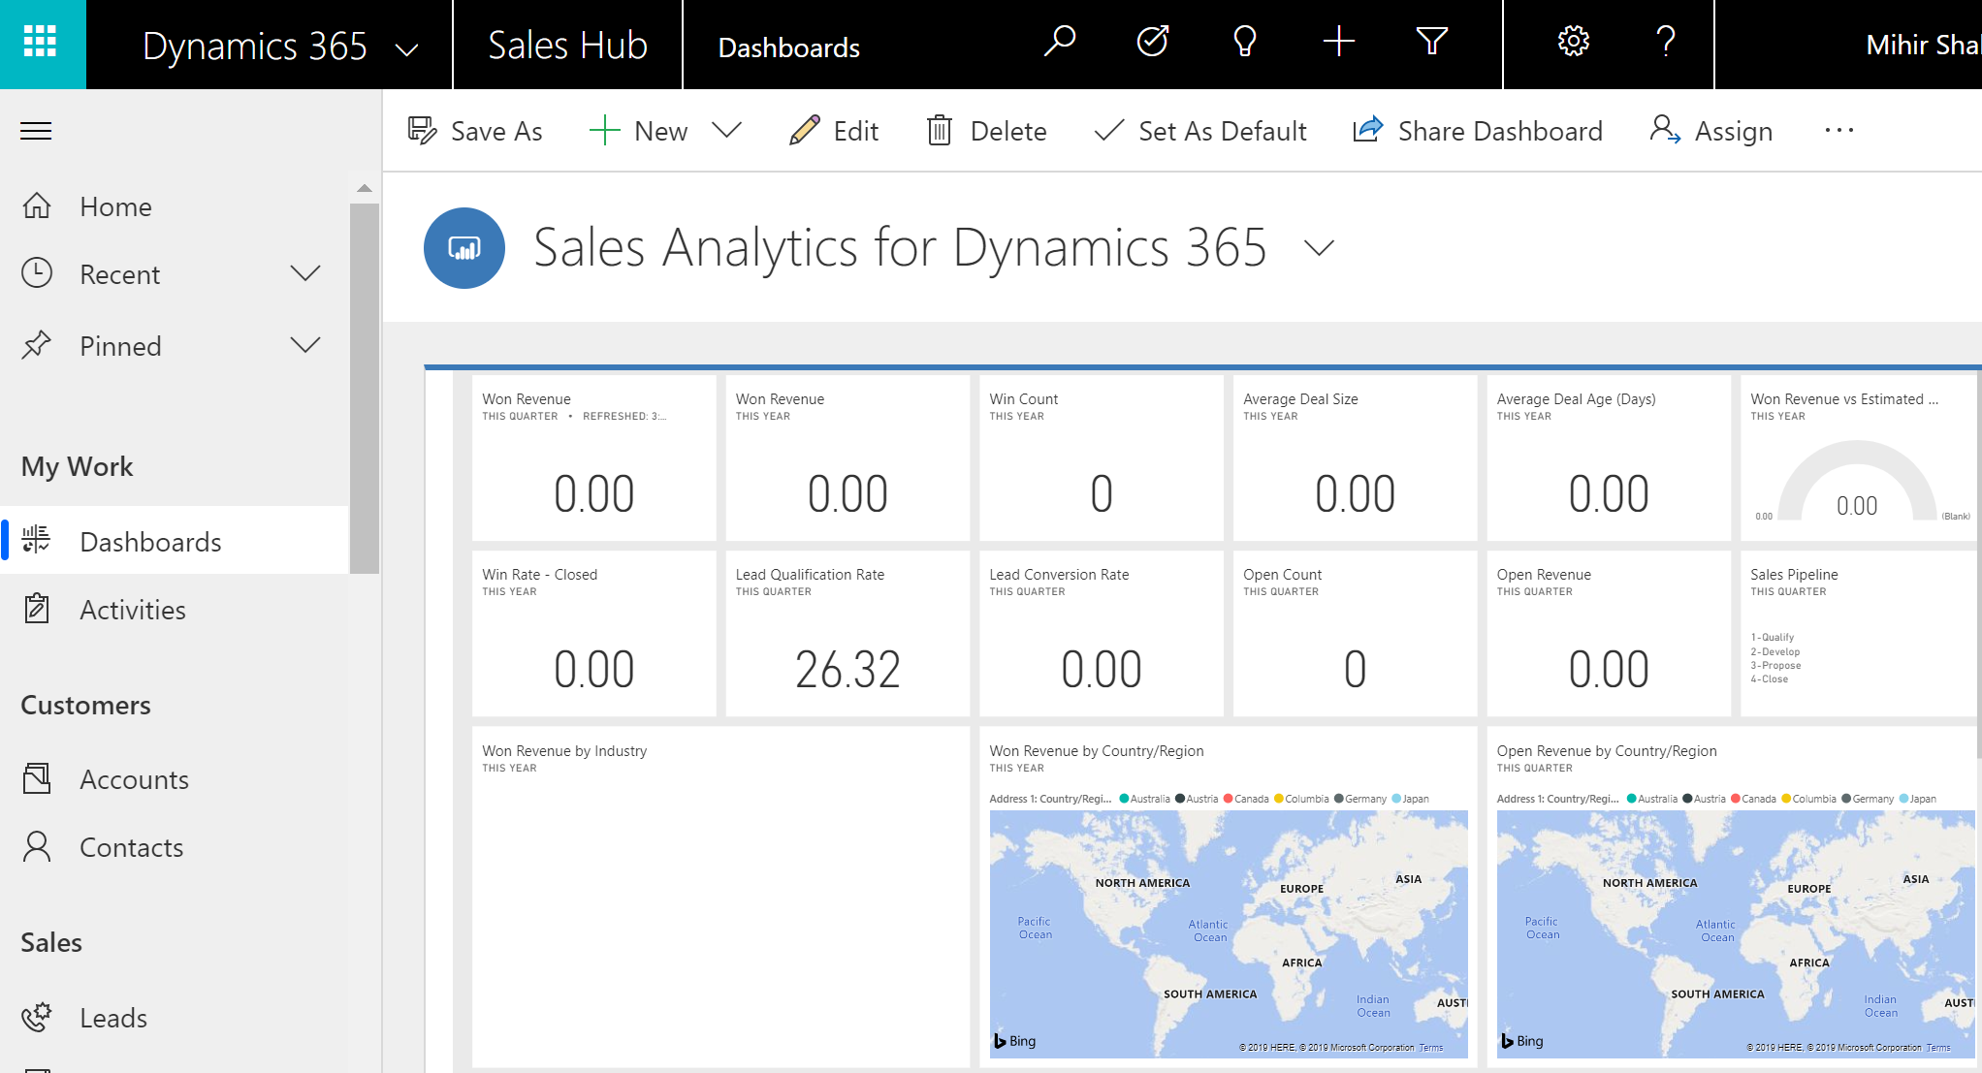
Add Power BI to Personal dashboard
Create a new Power BI personal dashboard
Share personal dashboard with team / users
Power BI with Dynamics 365 @mihircrm 02-29-2020

Slide 11
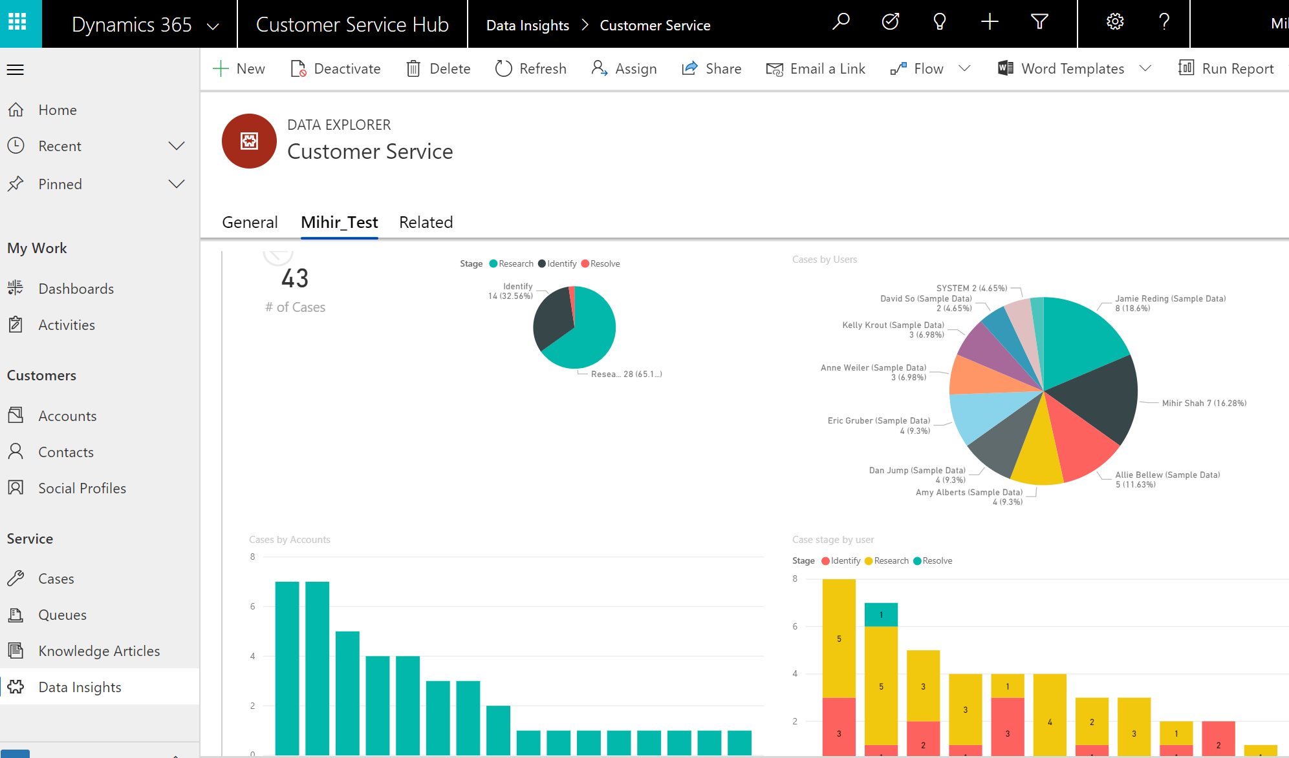
Add Power BI report to an entity form in D365
Using XRM Tool Box
Form XML Manager plugin
Power BI with Dynamics 365 @mihircrm 02-29-2020

Slide 12
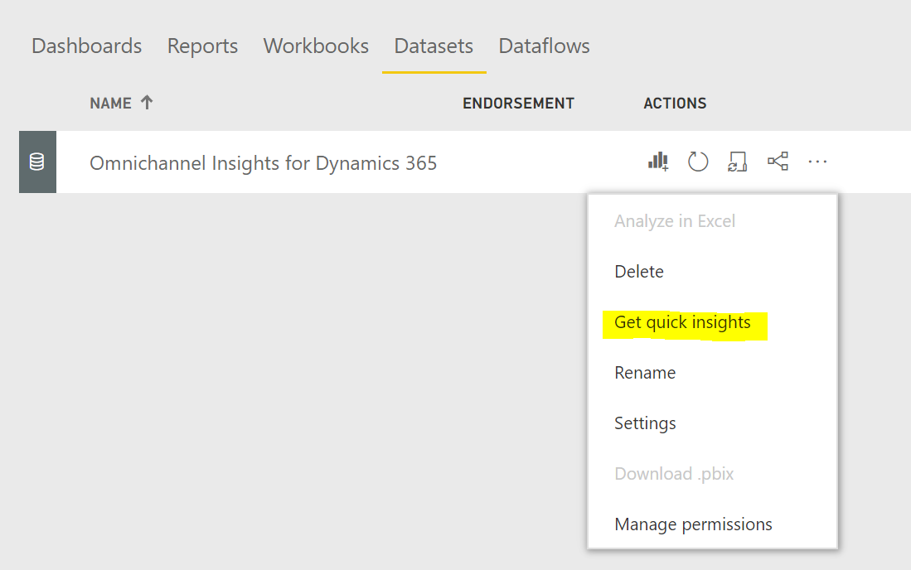
AI Insights from data in Power BI
Power BI with Dynamics 365 @mihircrm 02-29-2020

Slide 13
Power BI with Dynamics 365 Demo
Power BI with Dynamics 365 @mihircrm 02-29-2020

Slide 14
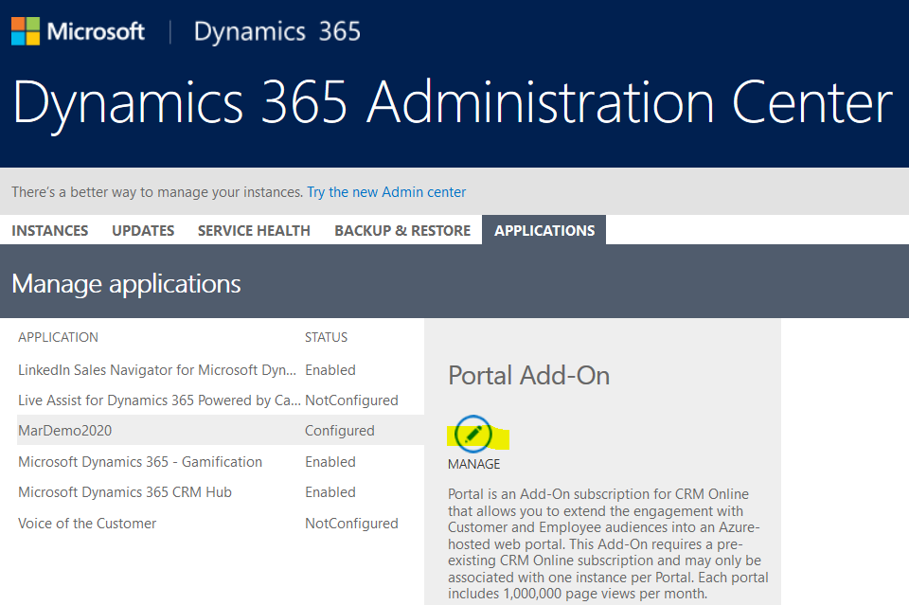
Manage the Portal
Power BI with Dynamics 365 @mihircrm 02-29-2020

Slide 15
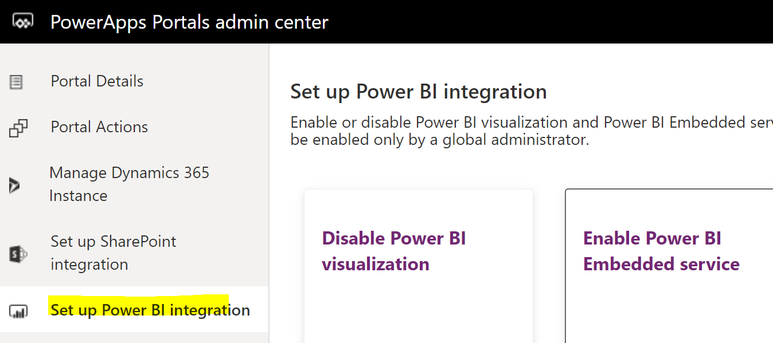
Enable visualization & embedded service
Power BI with Dynamics 365 @mihircrm 02-29-2020

Slide 16
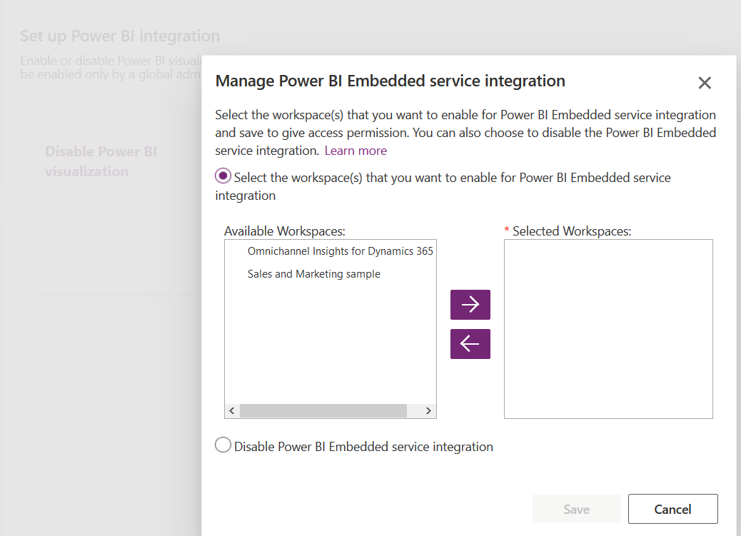
Select workspace
Power BI with Dynamics 365 @mihircrm 02-29-2020

Slide 17
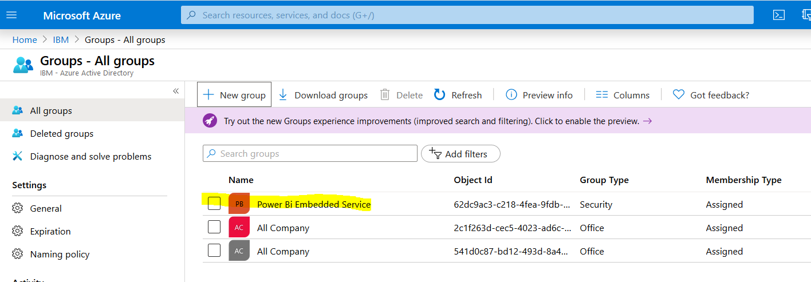
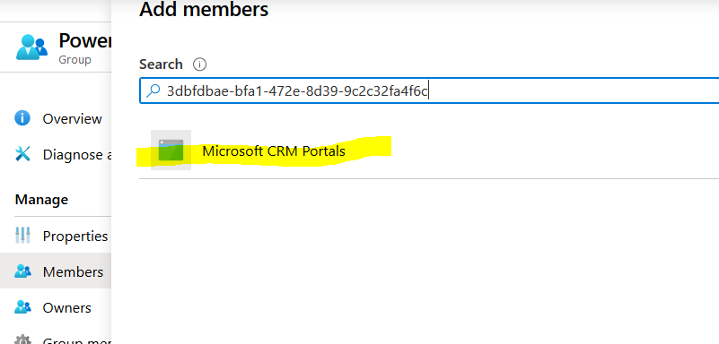
Setup Azure security group and add Portal App ID as member of the group
Power BI with Dynamics 365 @mihircrm 02-29-2020

Slide 18
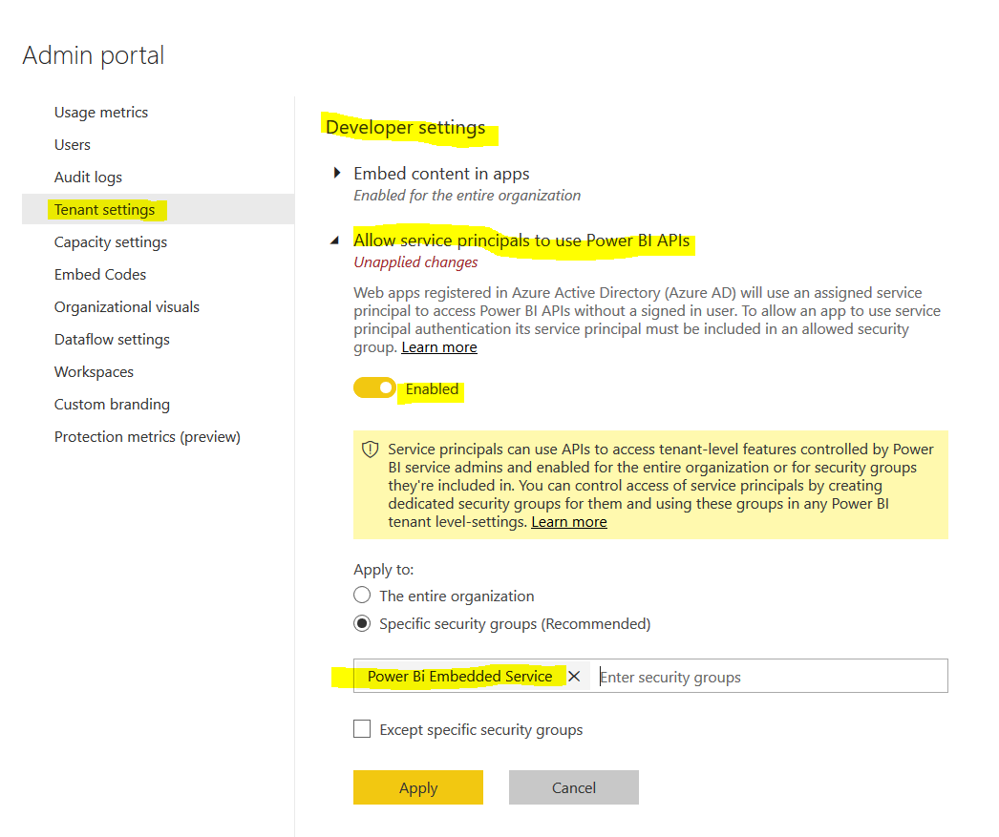
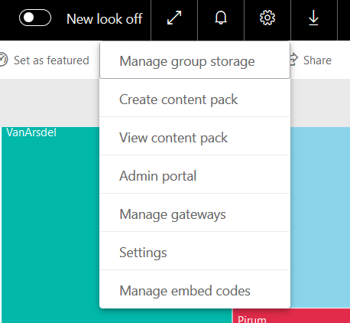
Add security group to Power BI admin portal
Power BI with Dynamics 365 @mihircrm 02-29-2020

Slide 19
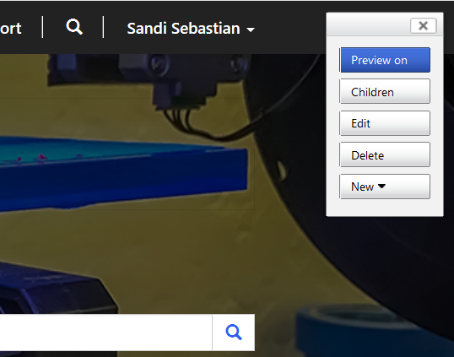
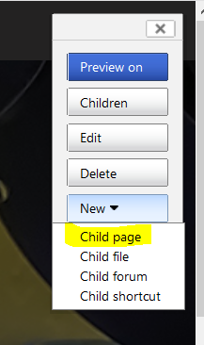
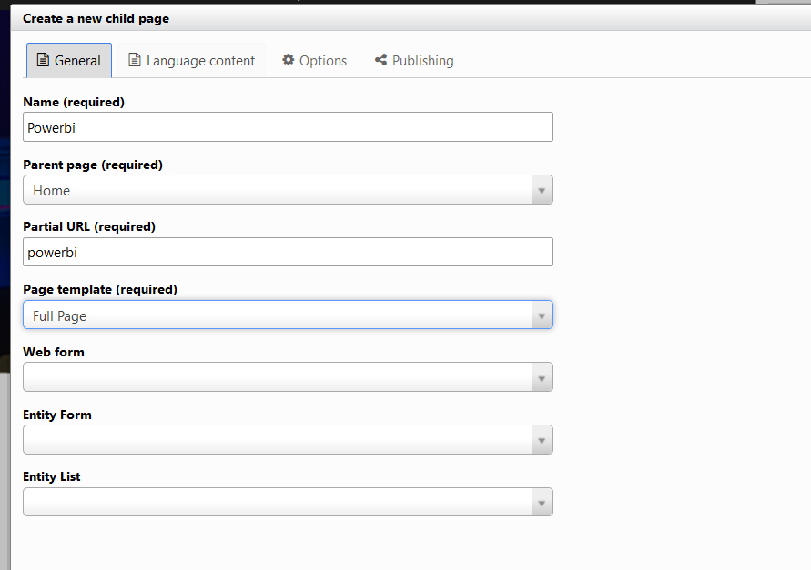
Create a new page for Power BI in Portal
Power BI with Dynamics 365 @mihircrm 02-29-2020

Slide 20
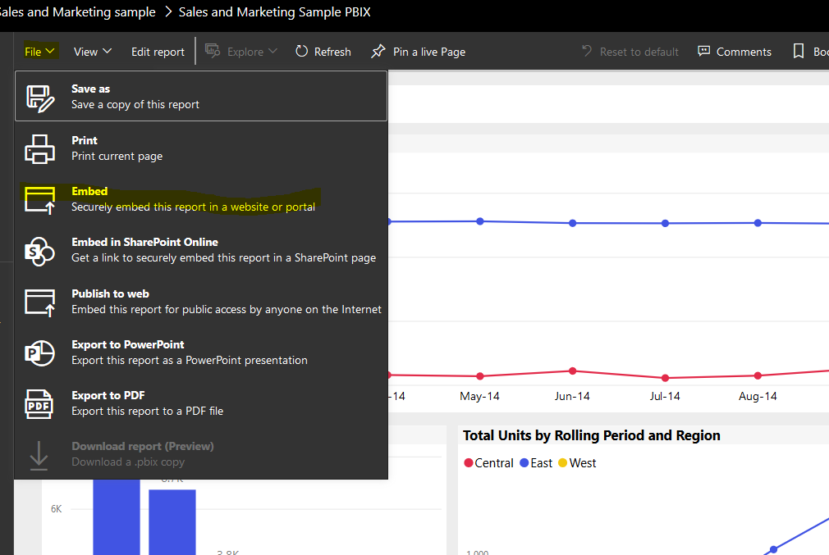
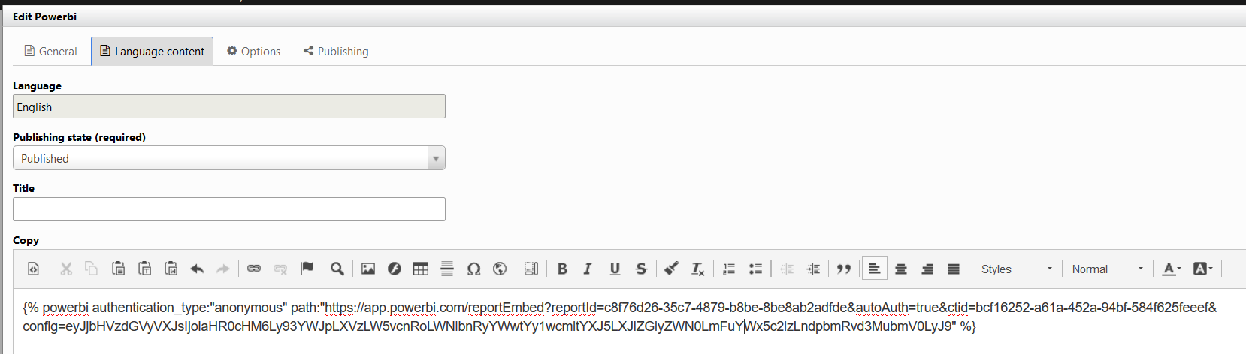
Embed Power BI report in Portal

Slide 21
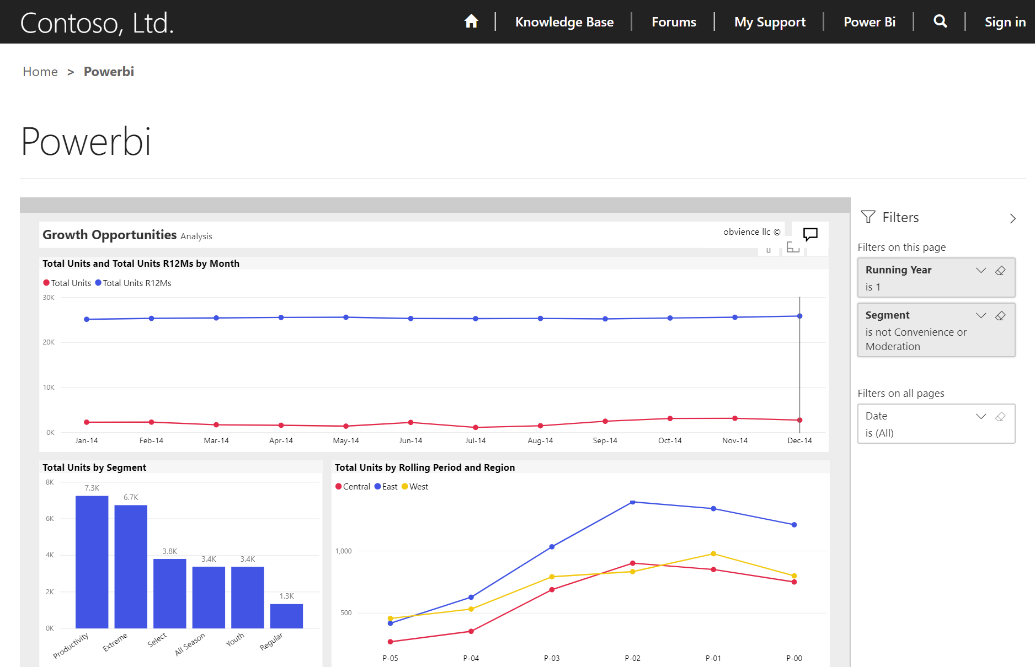
Power BI in Portals
Power BI with Dynamics 365 @mihircrm 02-29-2020

Slide 22
Power BI in Portals - demo
Power BI with Dynamics 365 @mihircrm 02-29-2020

Slide 23
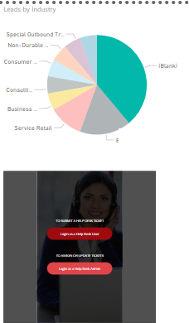
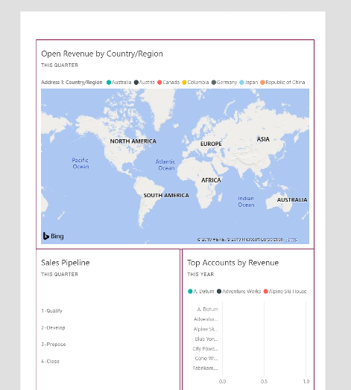
Power BI & Power Apps
Power BI in Power App
Power App in Power BI
Power BI with Dynamics 365 @mihircrm 02-29-2020

Slide 24
Security - Power BI & Dynamics 365
Security when using Power BI with Dynamics 365 / Power Apps
User authentication – It uses Azure Active Directory
Except connections to SQL Server Analysis Services using on premise data gateway
Sharing of Dataset, Report or Dashboard – Also gives access to the corresponding Data
Power BI and Dynamics 365 – Do NOT have the same security access rights and privileges
Power BI – Has Row Level Security – Configured in Desktop
Power BI with Dynamics 365 @mihircrm 02-29-2020

Slide 25
Takeaways
License – Power BI pro or premium
Security – Different security constructs
Dashboard – Personal only
AI / ML using Azure Data Lake – with Power BI Premium
Power BI with Dynamics 365 @mihircrm 02-29-2020

Slide 26
Q&A
References
Embedding Power BI dashboard in Portals – https://docs.microsoft.com/en-us/dynamics365/customer-engagement/portals/set-up-power-bi-integration#enable-power-bi-embedded-service
Embed Power BI dashboard in a Dynamics 365 form - https://docs.microsoft.com/en-us/powerapps/maker/model-driven-apps/embed-powerbi-report-in-system-form
Power Apps and Power BI - https://docs.microsoft.com/en-us/powerapps/maker/canvas-apps/powerapps-custom-visual
Power BI with Dynamics 365 @mihircrm 02-29-2020

Slide 27
Thank you
Power BI with Dynamics 365 @mihircrm 02-29-2020

